Slide 1
WISDOM
COURSE REGISTRATION SYSTEM
Team Members :
Ramya SP
Padmavathi H
Ganga R
Karpagalakshmi M

Slide 2
Content
Introduction
Purpose
Project Specification
Use case and ER Diagram
Modules and Flow Diagram
Future Scope
Demonstration
Conclusion

Slide 3
Introduction
Our Online course registration system “WISDOM”, offers various courses for students to learn. Our application is divided in three modules called Admin, Registrar and Student. Each modules has it’s own functionalities to perform which make our application unique.
The main aim of the project is to break the intricacies of modelling the database with the given requirements and using a web based interface to interact with the back end keeping in mind the data consistency and the stability of the entire system.

Slide 4
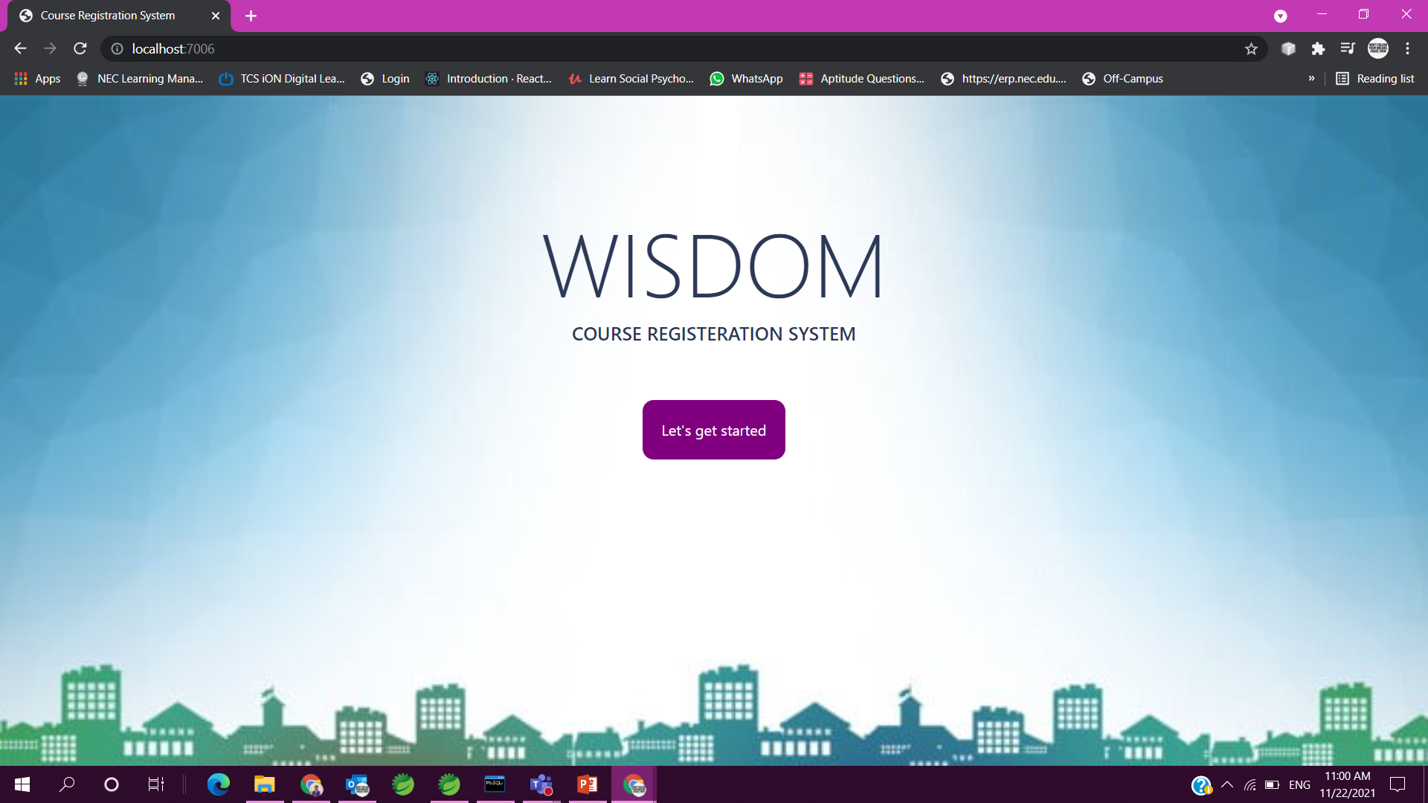

Slide 5
Purpose
To automate the course registration process without any physical human interaction.
To make the course registration process accessible anywhere to the student.
To allow the students to register in various courses they want to learn.
To allow the admin and registrar to efficiently manage their database and maintains the relationship in an effective manner.
To maintain data consistency and integrity.

Slide 6
Project Specification
Each module has its own login credentials to access our application.
Admin adds the registrar and gives them their username and password to access the application.
Each registrar has a unique registrar ID and a profile. The portal allows the registrar to add new courses, update his/her profile, view his/her courses and options to edit course fees and course capacity. A registrar can teach more than one course.
Each student has a unique student ID and a profile. The profile includes username, login password and other mandatory details.

Slide 7
Contd.,
Each course has a unique course ID, name and other features like course duration, fees for enrollment, capacity of the students and total number of seats available.
All these data’s of admin, registrar, student and course are saved in individual tables. A relationship is created between the user and course, registrar and course.
When the students enrollment reaches the given course capacity, the availability of seats become zero and it shows the course is Sold out.

Slide 8
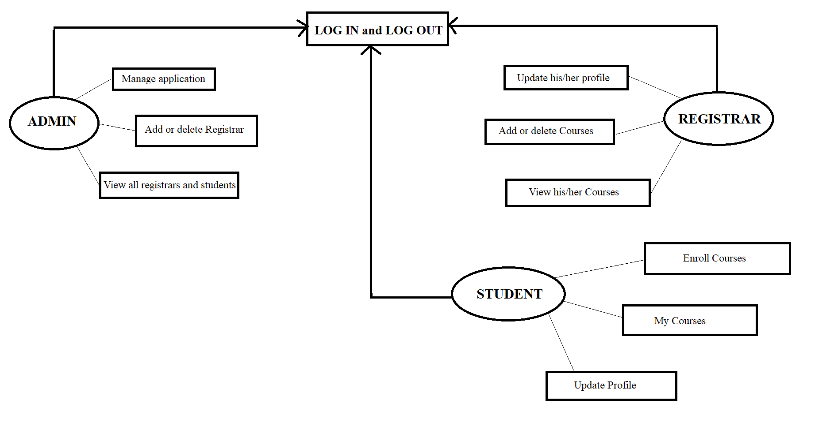
Use Case and ER Diagram

Slide 9
Password
Email
Mobile
Name
DOB
Username
ID
Gender
ID
ADMIN
Address
Password
View
STUDENT
M
Enroll
M
Add
M
M
COURSE
ID
ID
REGISTRAR
Year of Exp.
Password
Name
Name
Seats Availability
Capacity
Fees
Duration
Email
Mobile
Gender
DOB

Slide 10
Admin Module
Admin adds the new registrars for the application and gives them a username and password.
They can view the list of all registrars added to the application and also search them by their username.
They can also delete the registrar if needed.
They can view all the courses added by all the registrars.
They can view all the students who have created an account in this application.
They can also view the students who have enrolled for the particular course.

Slide 11
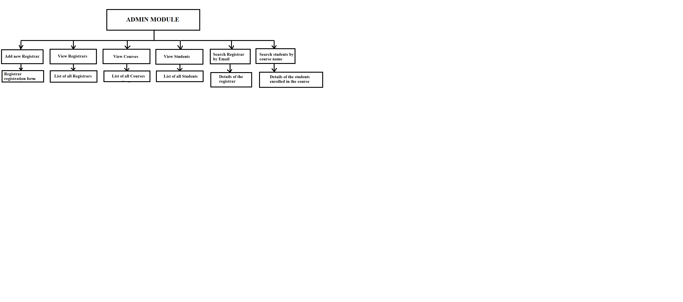
Flow Diagram

Slide 12
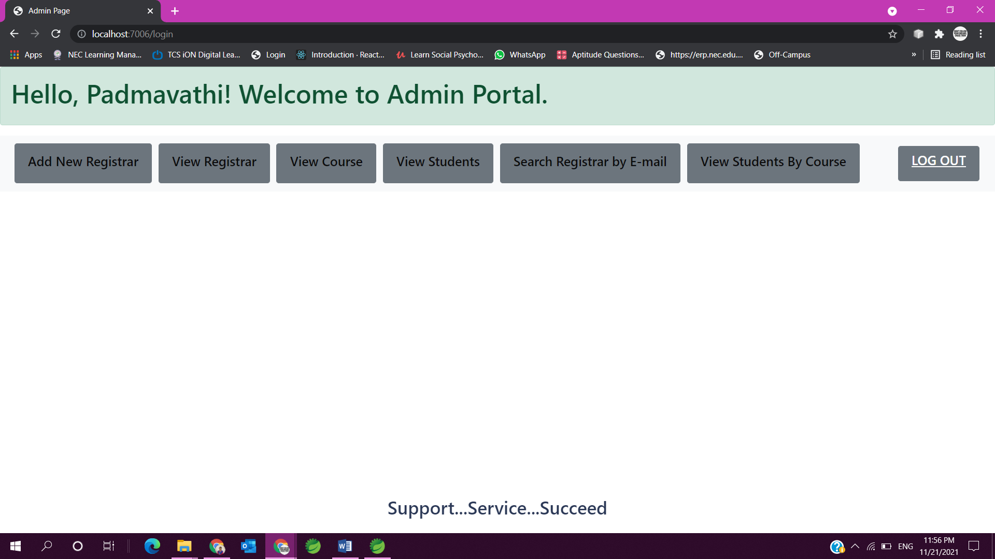

Slide 13
Registrar Module
Registrar gets login with the username and password given by the admin.
They can update their profile using the update profile button where the details are updated along with their password.
They can add new course which has attributes like name, duration, capacity and seats availability.
Whenever a course is added, a relationship is created between the registrar and course tables.
They can view all the courses they have added and can edit the course fees along with the course capacity if needed. When the capacity is increased the seat availability also increases.

Slide 14
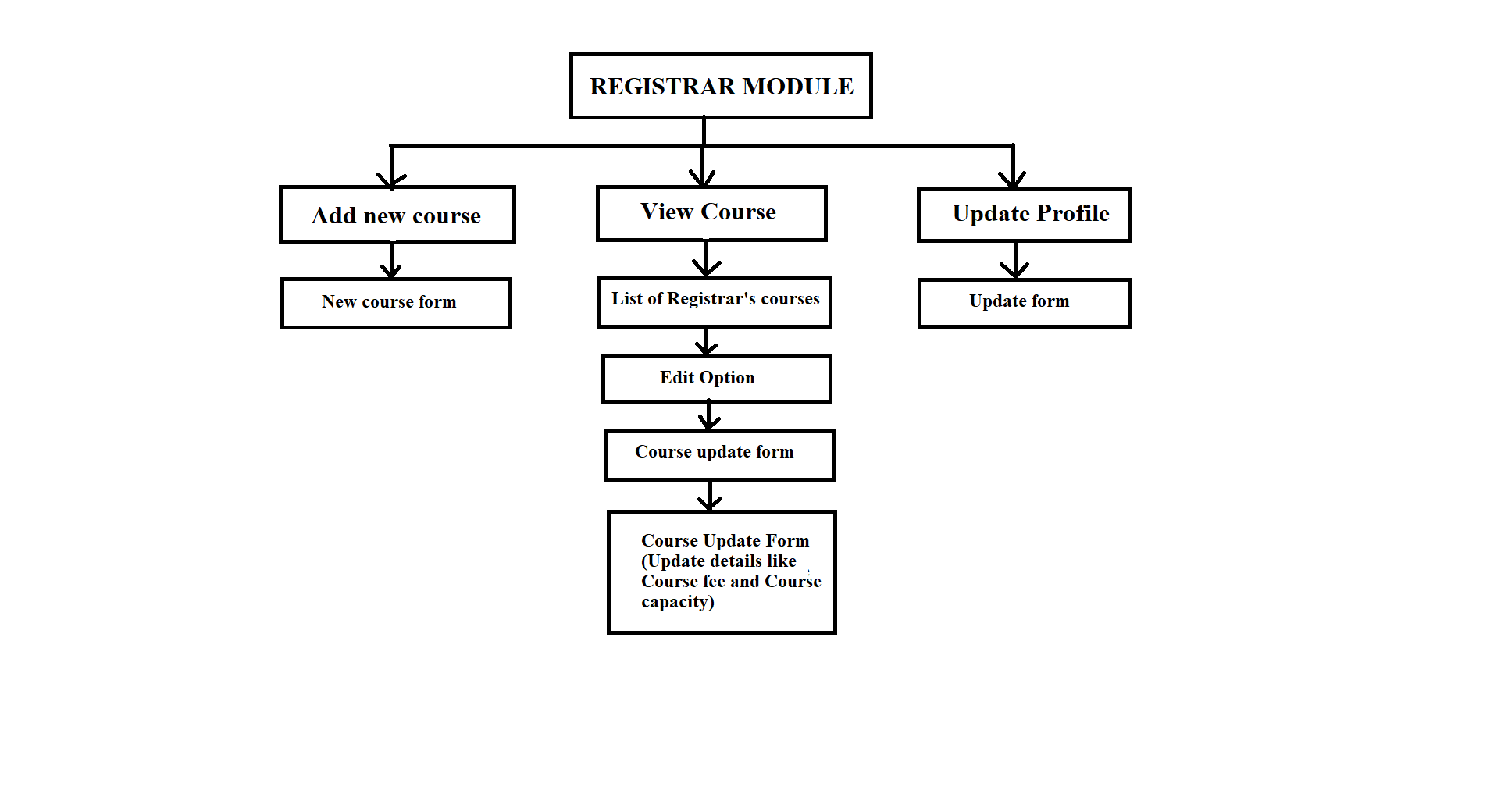
Flow Diagram

Slide 15
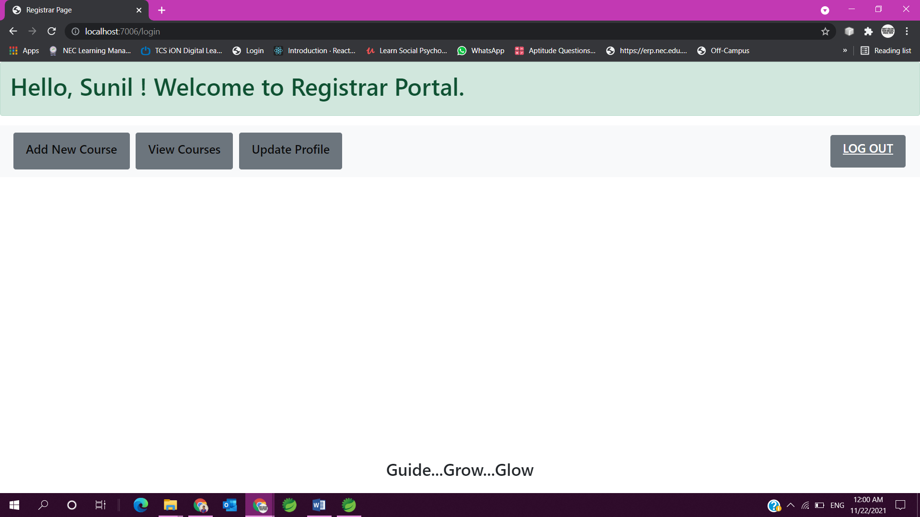

Slide 16
Student Module
Student needs to create an account first using the sign up link where they enter their details and set password for them.
They can update their profile also.
They can view the list of all courses added by the registrar and get enrolled in any of the courses.
When the student gets enrolled in a particular course, a relationship is established between the student and courses.
They can view the list of all courses they have enrolled.

Slide 17
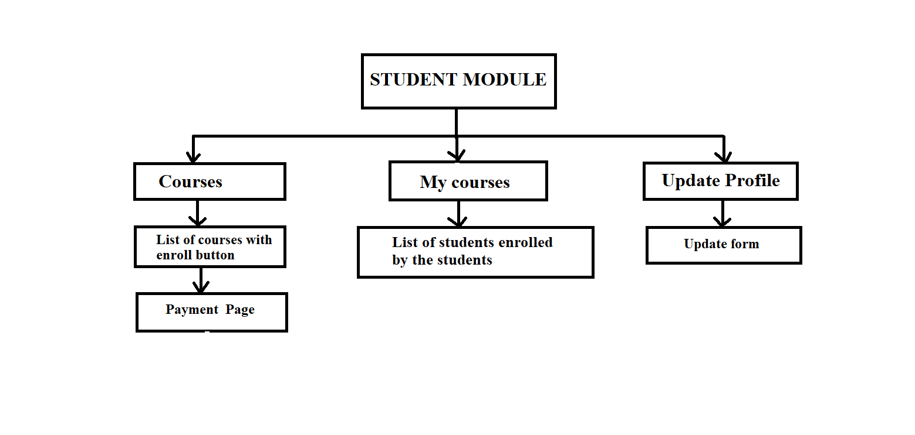
Flow Diagram

Slide 18
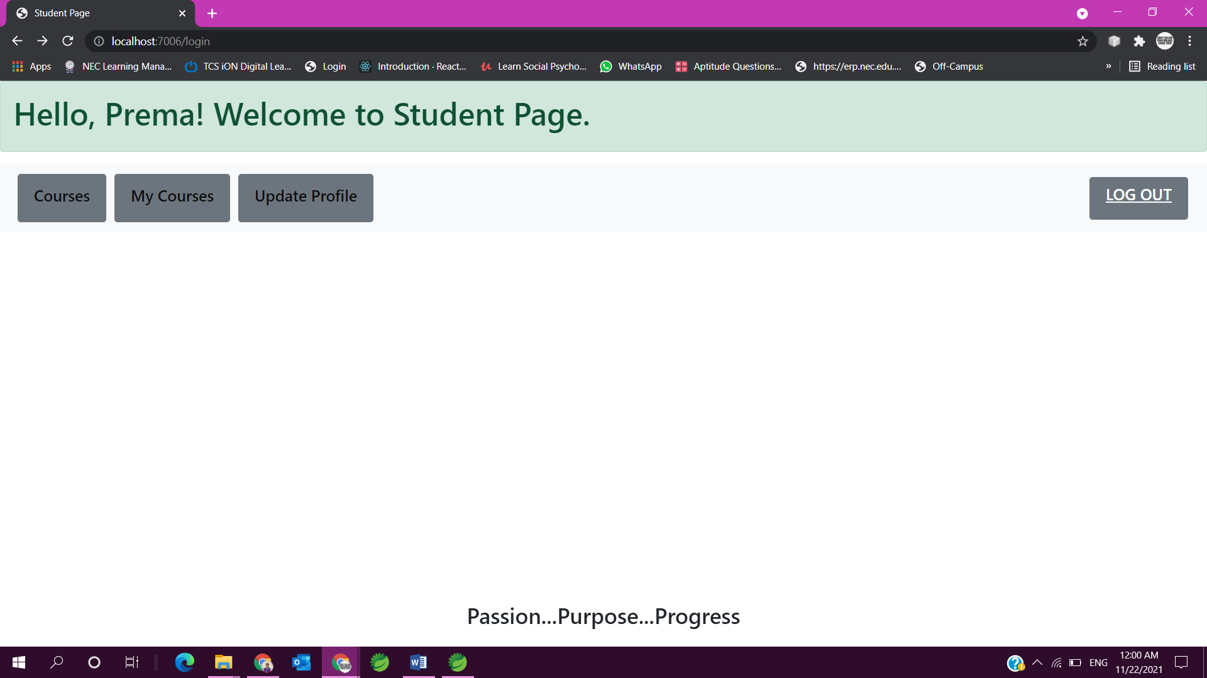

Slide 19
Demonstration

Slide 20
Future Scope
To display the students who have enrolled in the particular course added by the registrar in Registrar Portal.
To make our table mapping much more effective to access.
To add logo to our application.
To make our UI part even more user friendly.

Slide 21
Conclusion
Our application’s main goal is providing online learning portal for the students where they can choose the courses to learn from anywhere and it is achieved. It is complete in the sense that it is operational and it is tested by entering data and achieving the requirements. But there is always a scope for improvement and enhancement according to our client’s need. We hope to achieve them and make our application even more productive.

Slide 22
Thank you

